Slide 1
Computer Programming Basics
Jeon, Seokhee
Assistant Professor
Department of Computer Engineering,
Kyung Hee University, Korea

Slide 2
CHAPTER 6
Repetition

Slide 3
Why Do We Need Repetition?
Sometimes we want to do things more than once.
  E.g., Calculate the grades of 160 students
  E.g., Calculate the sum of 1~100
How?
  Cut and paste the codes 160 times?
  cout << 1 + 2 + ……+100 << endl; ??
  Then, what about summing up 1~10000?

Slide 4
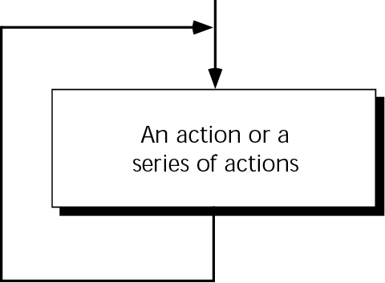
Concept of Loop
Loop: The real power of computers!

Slide 5
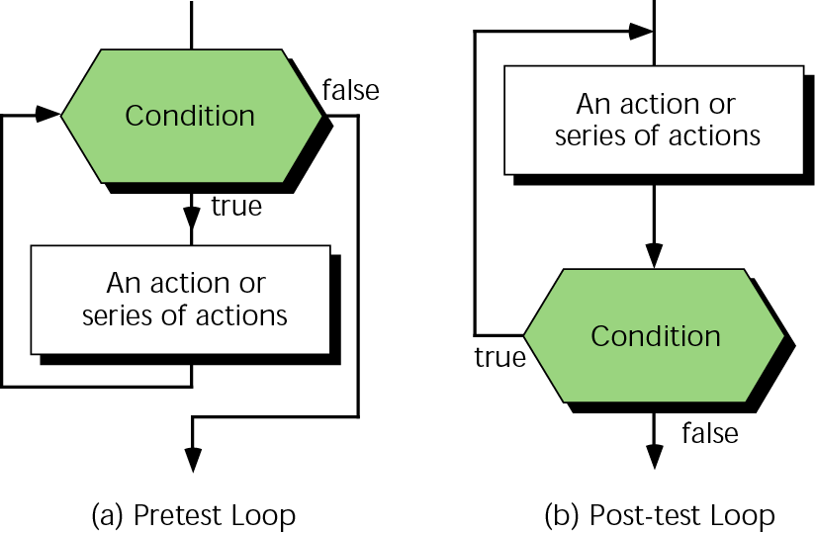
Stopping the Loop

Slide 6
Question: When to Check Loop-End Condition?

Slide 7
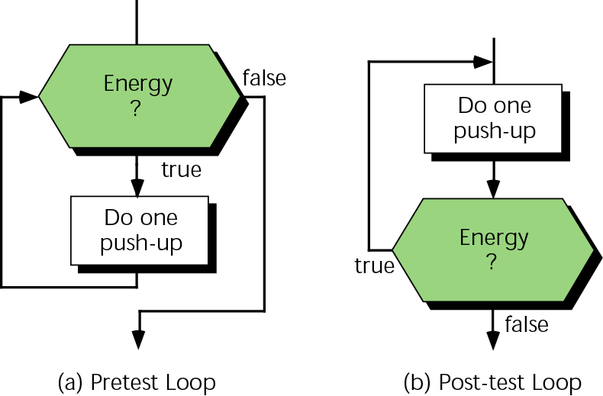
Two Different Strategies for Starting Exercise

Slide 8
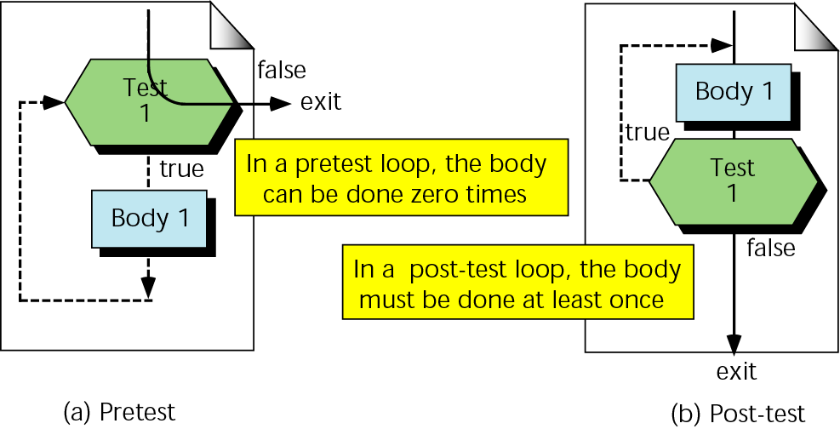
Minimum Number of Iterations in Two Loops

Slide 9
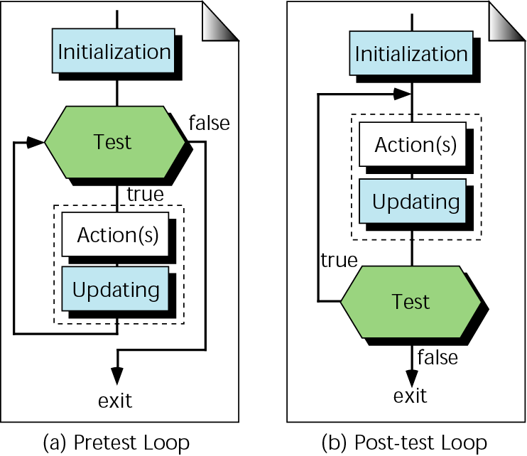
Loop Initialization and Updating

Slide 10
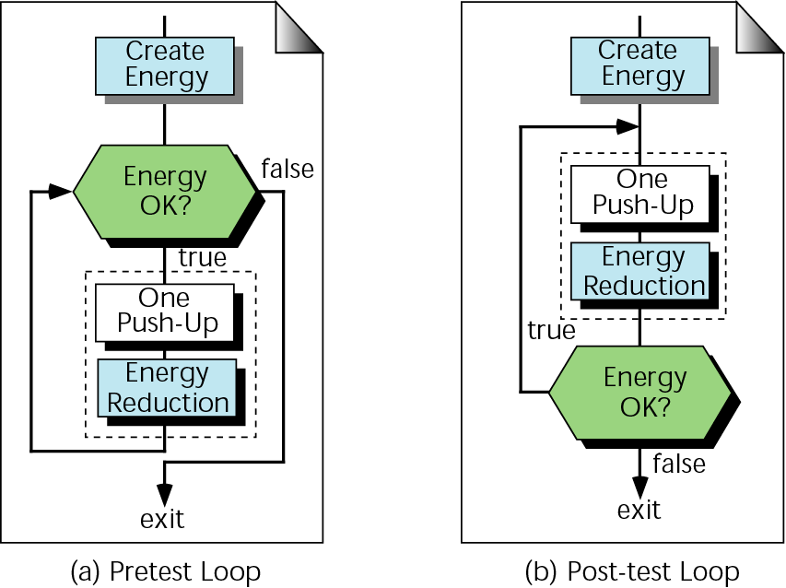
Initialization and Updating for Exercise

Slide 11
Question: When to Stop a Loop?
Counter-Controlled Loop
  Know how many times to loop when a loop begins
  E.g., do the summing calculation 100 times.
Event-Controlled Loop
  Don’t know how many times, but knows how world will be when done
  E.g., end the exercise when energy runs out

Slide 12
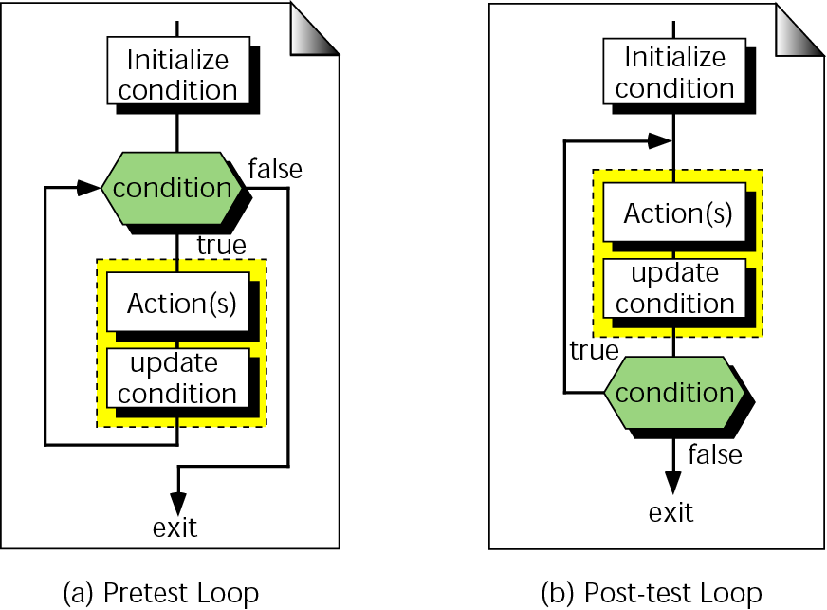
Event-Controlled Loop Concept

Slide 13
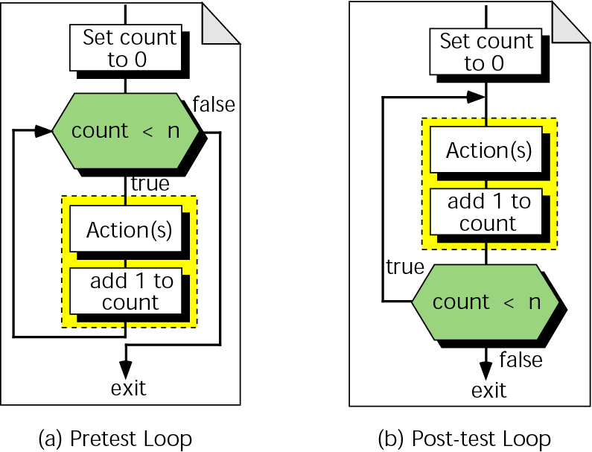
Counter-Controlled Loop Concept

Slide 14
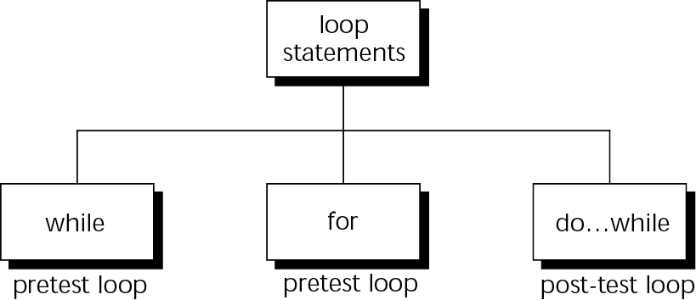
Loops in C++
Usually used for event-controlled loop
Usually used for counter-controlled loop
Usually used for event-controlled loop

Slide 15
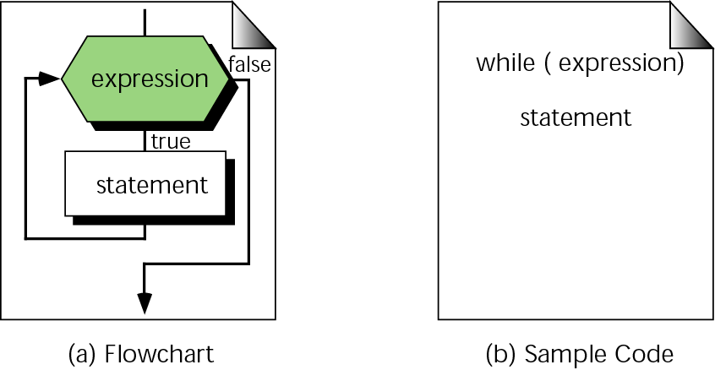
The while Statement

Slide 16
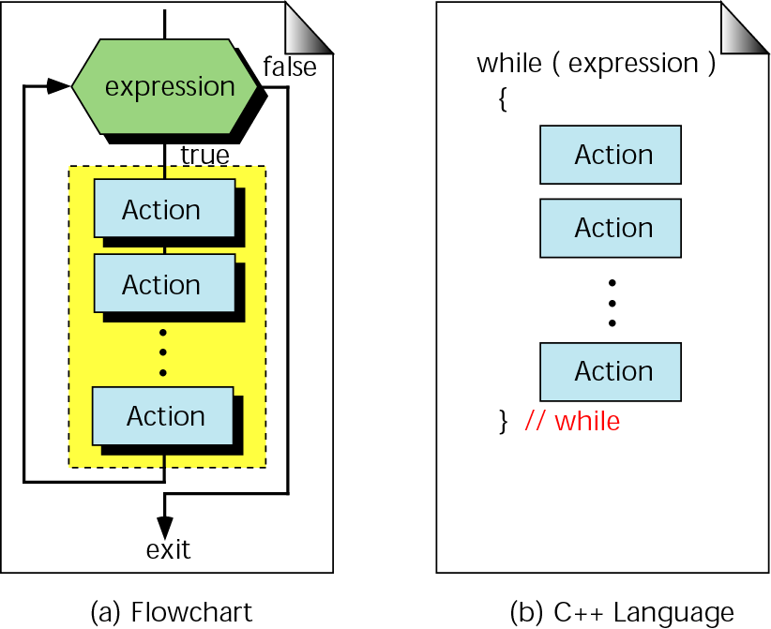
The Compound while Statement

Slide 17
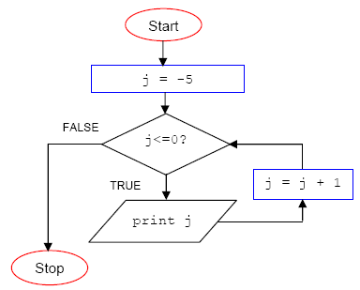
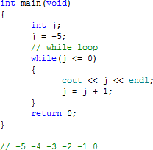
Examples of while Loop

Slide 18
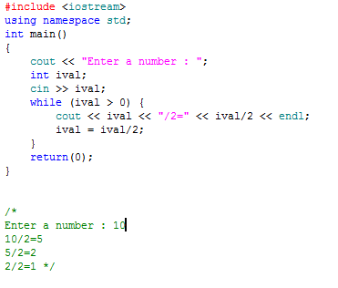

Slide 19
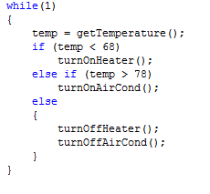
Heating System Control Example

Slide 20
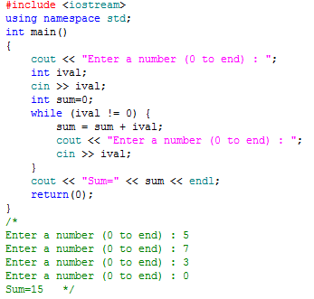

Slide 21
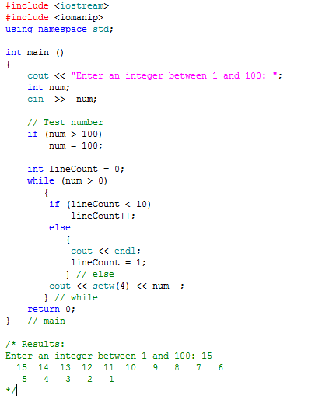

Slide 22
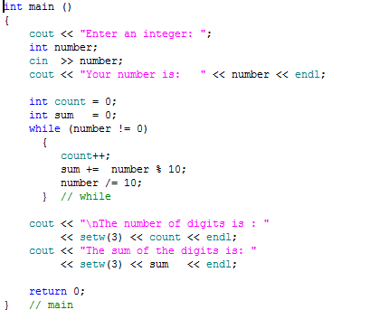

Enter an integer: 12345
Your number is: 12345
The number of digits is: 5
The sum of the digits is: 15

Slide 23
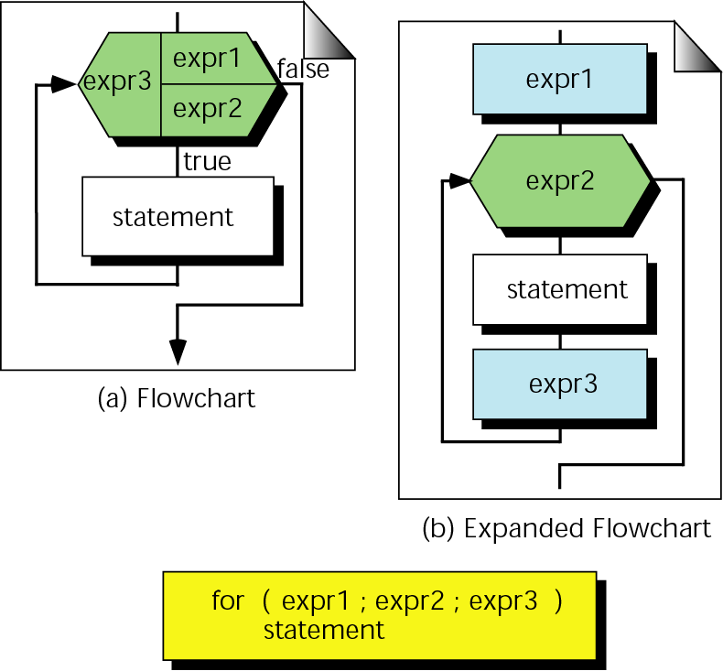
The for Statement

Slide 24
A for loop is used when your loop is to be executed a known number of times. You can do the same thing with a while loop, but the for loop is easier to read and more natural for counting loops.

Slide 25
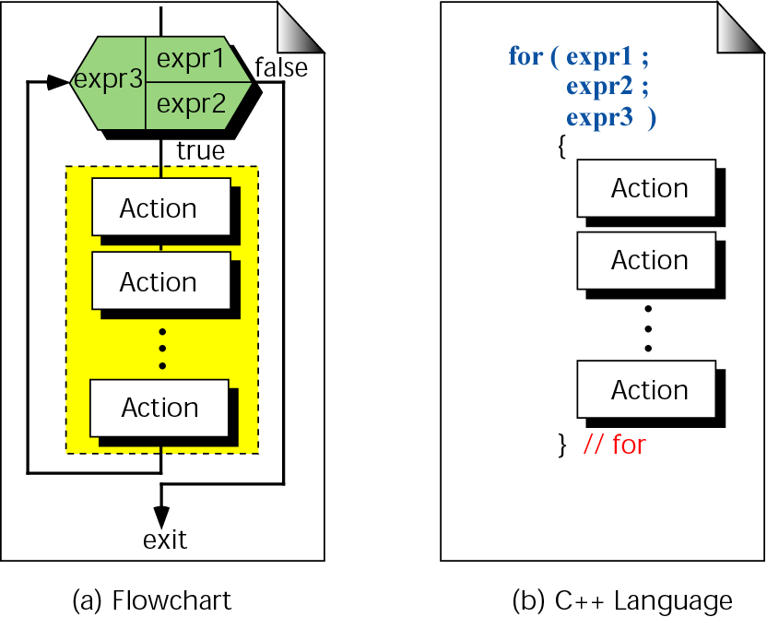
The Compound for Statement

Slide 26
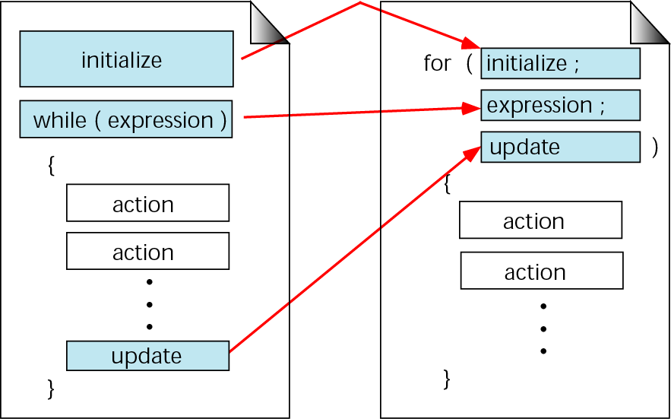
Comparing for and while Loops

Slide 27
Conversion from while to for Loop

Slide 28

int main()
{
int j;
j = -4;
while(j <= 0)
{
cout << j << endl;
j = j + 1;
}
return 0;
}
int main()
{
int j;
j = -4;
for( ; j <= 0 ; )
{
cout << j << endl;
j = j + 1;
}
return 0;
}

Slide 29
int main()
{
int j = -4;
for( ; j <= 0 ; )
{
cout << j << endl;
j = j + 1;
}
return 0;
}
int main()
{
int j;
for(j = -4; j <= 0 ; )
{
cout << j << endl;
j = j + 1;
}
return 0;
}

Slide 30
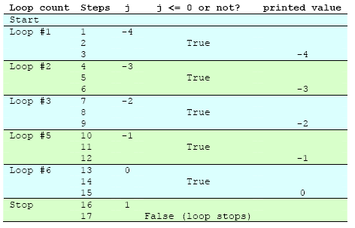
Step by Step Trace
int main()
{
int j;
for(j = -4; j <= 0 ; j = j + 1)
{
cout << j << endl;
}
return 0;
}

Slide 31
Examples!
for(i = 2; i <= 6; i = i + 2)
cout << i+1 << ‘\t’;
for(i = 2; i != 11; i = i + 3)
cout << i+1 << ‘\t’;
cout << "\nPlease enter a limit: ";
cin >> limit;
for (i = 1; i <= limit; i++)
cout << "\t" << i << endl;
Please enter the limit: 3
1
2
3
0 10
1 9
2 8
3 7
4 6
for (n=0,i=10;n!=I;n++,i--)
cout << n <<"\t" << i << endl;

Slide 32
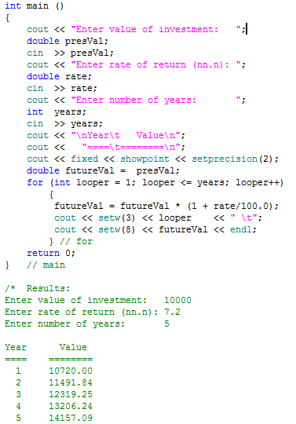
Compound Interest

Slide 33
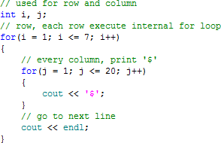
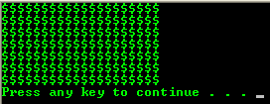
Nested for Loop

Slide 34
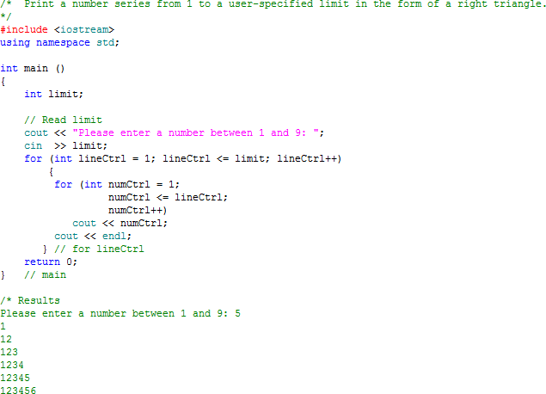

Slide 35
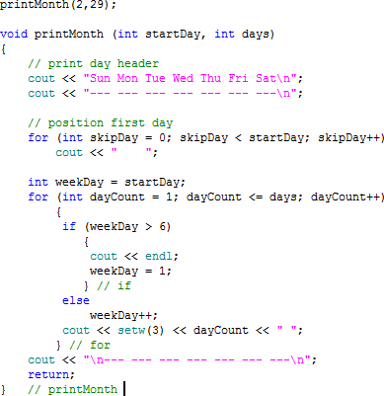
Sun Mon Tue Wed Thu Fri Sat
--- --- --- --- --- --- ---
1 2 3 4 5
6 7 8 9 10 11 12
13 14 15 16 17 18 19
20 21 22 23 24 25 26
27 28 29
--- --- --- --- --- --- ---

Slide 36
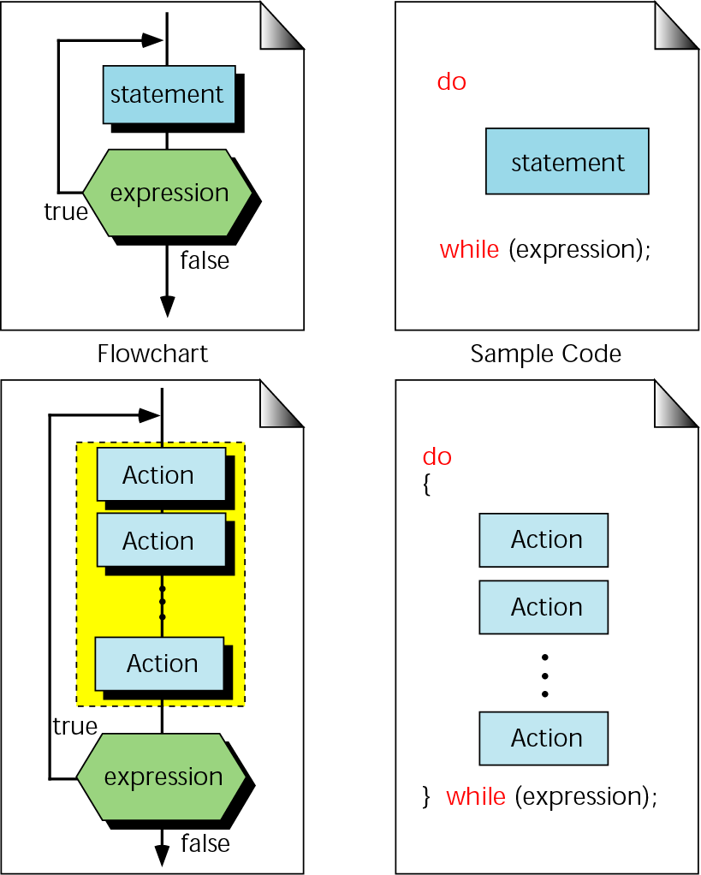
Format of the do…while Statement

Slide 37
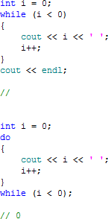
while vs. do … while
Print nothing because the i<0 is checked prior to the cout
Print 1. cout is executed at least once
Before checking the i<0

Slide 38
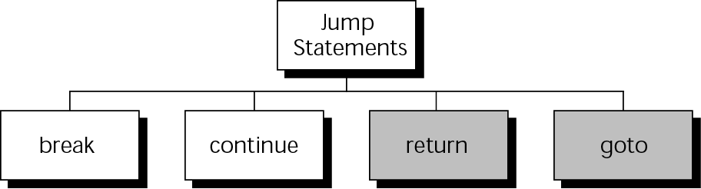
Other Statements Related to Looping

Slide 39
break Statement
Unconditional loop exit
for(…;…;…) or while(…)
{
…
break;
…
}
…
Terminate the loop and execution jumps to here

Slide 40
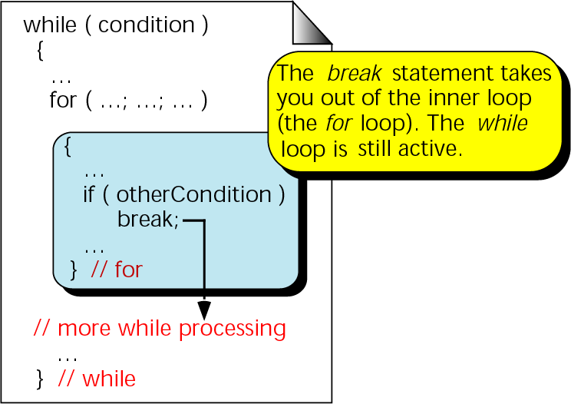
break in Nested Loop

Slide 41
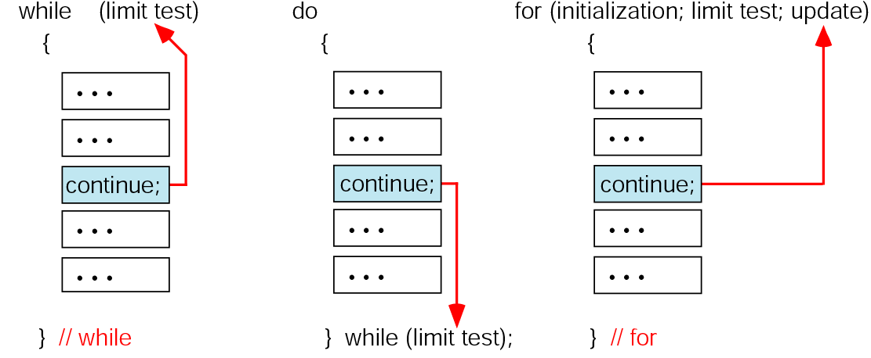
continue Statement
  Skip the rest of the loop body without exiting the loop

Slide 42
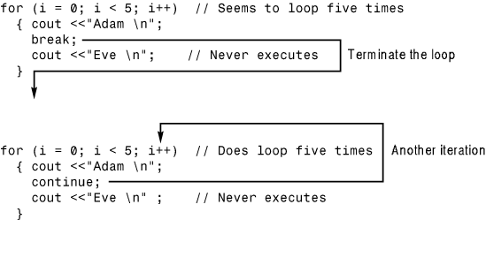
break vs. continue
Result:
Adam
Result:
Adam
Adam
Adam
Adam
Adam

Slide 43
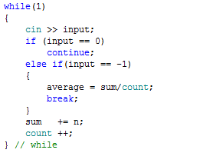
break and continue Examples

Slide 44
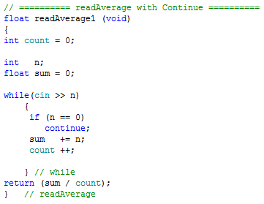
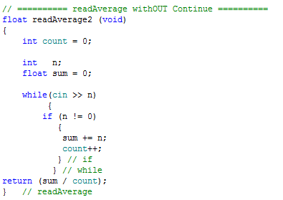
continue Statement Example

Slide 45
Recursion
A repetitive process in which a function calls itself
E.g.,
  type fun(…)
  {
  if(…)
  fun(…)
  else
  return …;
  }

Slide 46
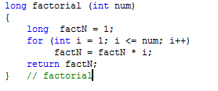
Recursion Example
Factorial – Conventional Formula
factorial(n) =
  if n is 0, then 1
  If n > 0, then n*(n-1)*(n-2)*…3*2*1
E.g., factorial(4) = 4 * 3 * 2 * 1 = 24

Slide 47
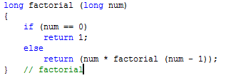
Recursion Example
Factorial – Recursive Formula
factorial(n) =
  if n is 0, then 1
  If n > 0, then n*(Factorial(n-1))
E.g., factorial(4) = 4*factorial(3) = … = 24

Slide 48
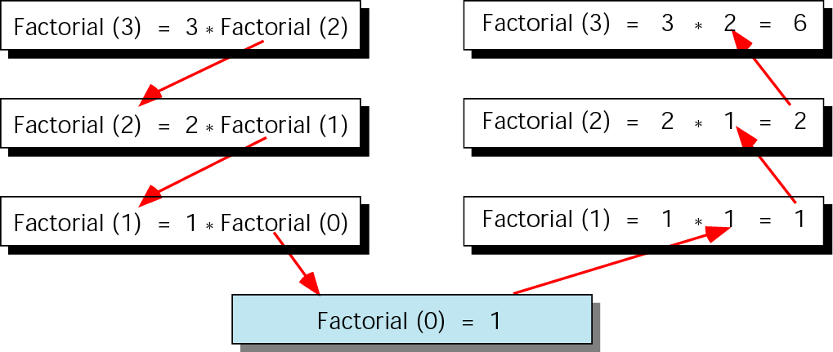
Factorial (3) Recursively

Slide 49
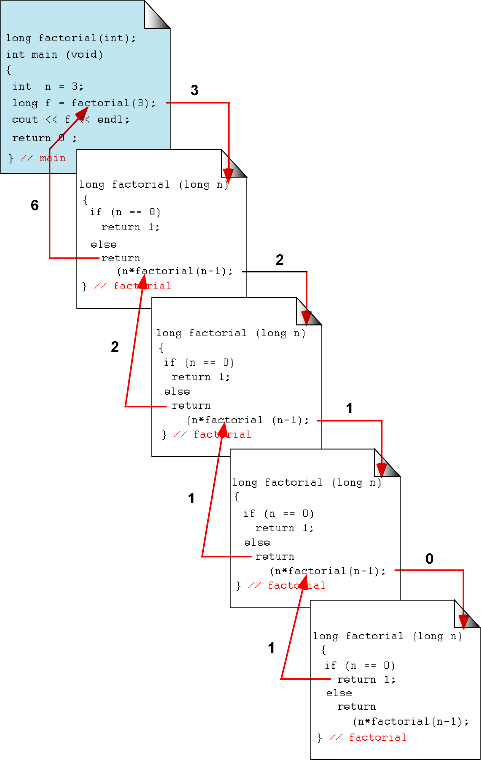
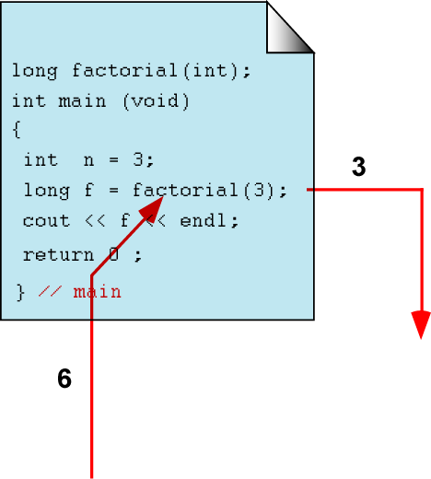
Calling a Recursive Function

Slide 50
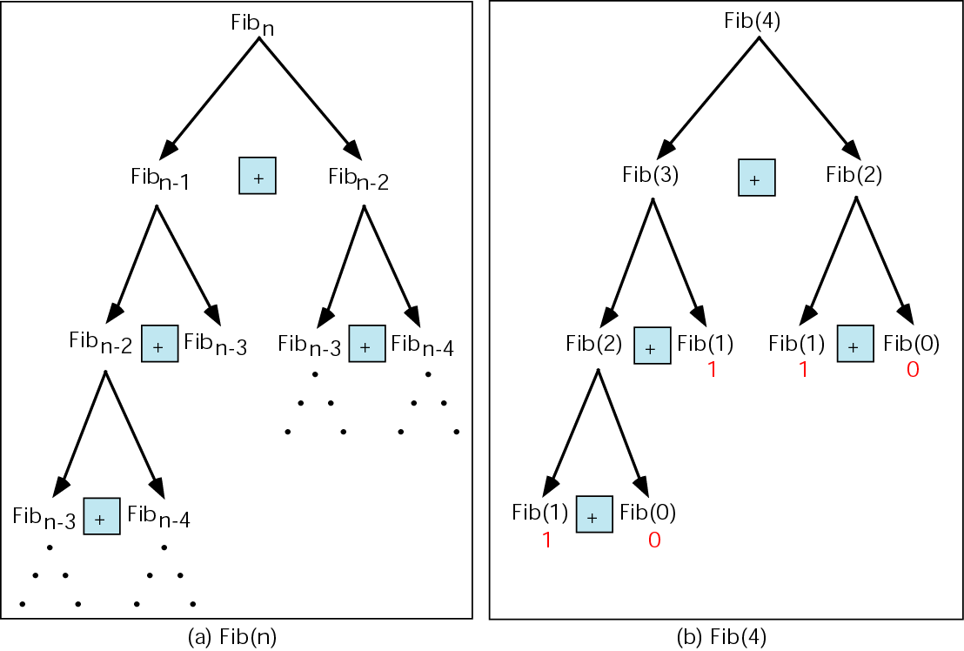
Recursion Example
Fibonacci Numbers

Slide 51
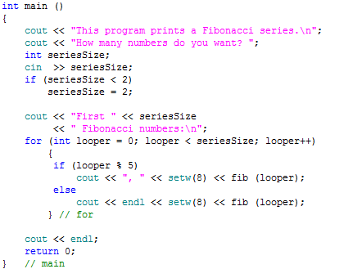
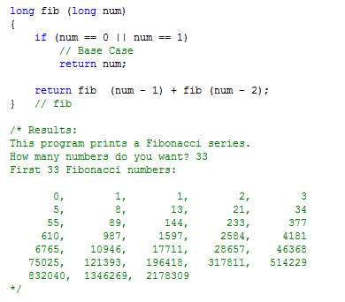

Slide 52
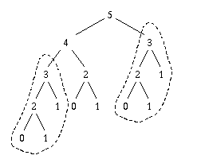
Fibonacci Numbers
-Better Algorithm
Let's consider all the recursive calls for fib(5).
There's a lot of repeated work. For example, the call to fib(4) repeats the calculation of fib(3)
In general, when n increases by 1, we roughly double the work; that makes about 2^{n} calls!

Slide 53
Fibonacci Numbers
-Better Algorithm
Don't recompute the previous two, but just write them down (or remember them).
k is the place we've come so far in writing out the series. When k reaches n, we're done.
int helpFib(int n, int k, int fibk, int fibk1) {
if (n == k) return fibk;
else return helpFib(n, k+1, fibk+fibk1, fibk);
}
int fib(int n) {
return helpFib(n, 1, 1, 0);
}

Slide 54
Fibonacci Numbers
-Better Algorithm
fib(6)
helpFib(6, 1, 1, 0)
helpFib(6, 2, 1, 1)
helpFib(6, 3, 2, 1)
helpFib(6, 4, 3, 2)
helpFib(6, 5, 5, 3)
helpFib(6, 6, 8, 5)
=> 8
Need n iterations to compute fib(n). That is much better than 2^{n}.

Slide 55
Every recursive call must either solve part of the problem or reduce the size of the problem.

Slide 56
Greatest Common Devisor
Brute Force Algorithm Using Recursion
int tryDivisor(int m, int n, int g) {
if (((m % g) == 0) && ((n % g) == 0))
return g;
else
return tryDivisor(m, n, g - 1);
}
int gcd(int m, int n) {
return tryDivisor(m, n, n); // use n as our first guess
}
gcd(6, 4)
tryDivisor(6, 4, 4)
tryDivisor(6, 4, 3)
tryDivisor(6, 4, 2)
=> 2

Slide 57
Greatest Common Devisor
Brute Force Algorithm Using while Loop
int GreatestCommonDivisor (int a, int b) {
int n = min (a, b);
int gcd = 1, i = 1;
while (i <= n) {
if (a % i == 0 && b % i == 0)
gcd = i;
i++;
}
return gcd;
}

Slide 58
Greatest Common Devisor
Euclid's Algorithm Using Recursion
The idea:
gcd(a,b)=gcd(b,a mod b)
gcd(a,0)=a
int gcd(int m, int n) {
if ((m % n) == 0)
return n;
else
return gcd(n, m % n);
}
gcd(468, 24)
gcd(24, 12)
=> 12
gcd(135, 19)
gcd(19, 2)
gcd(2, 1)
=> 1

Slide 59
Greatest Common Devisor
Euclid's Algorithm Using while Loop
int GreatestCommonDivisor (int a, int b) {
while (b != 0) {
int r = a % b;
a = b;
b = r;
}
return a;
}

Slide 60
Greatest Common Devisor
Dijkstra's Algorithm Using Recursion
The idea: If m>n, GCD(m,n) is the same as GCD(m-n,n).
int gcd(int m, int n) {
if(m == n)
return m;
else if (m > n)
return gcd(m-n, n);
else
return gcd(m, n-m);
}
This does accomplish the calculation with no division.
gcd(468, 24)
gcd(444, 24)
gcd(420, 24)
...
gcd(36, 24)
gcd(12, 24) (Now n is bigger)
gcd(12, 12) (Same)
=> 12

Slide 61
Greatest Common Devisor
Dijkstra's Algorithm Using while Loop
int GreatestCommonDivisor (int a, int b) {
int c;
while (a != b) {
while (a > b) {
c = a - b;
a = c;
}
while (b > a) {
c = b - a;
b = c;
}
}
return a;
}

Slide 62
Prime Number Example
A prime number is a natural number that has exactly two distinct divisors: 1 and itself. (Comment: 1 is not prime)
Write a program that reads a natural number (N) and tells whether it is prime or not.
Algorithm: try all potential divisors from 2 to N‐1 and check whether the remainder is zero.
from http://www.lsi.upc.edu/~jordicf/Teaching/programming/pdf4/IP03_Loops-4slides.pdf

Slide 63
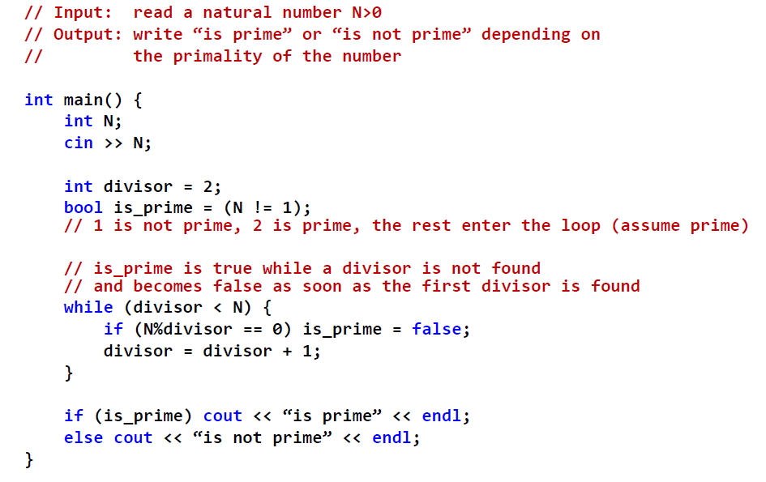

Slide 64
Prime Number Example
Observation: as soon as a divisor is found, there is no need to check divisibility with the rest of the divisors.
However the algorithm tries all potential divisors from 2 to N‐1.
Improvement: stop the iteration when a divisor is found.

Slide 65
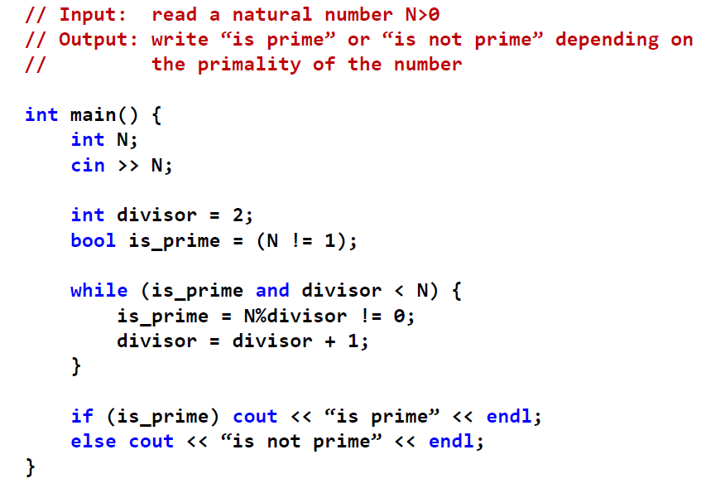

Slide 66
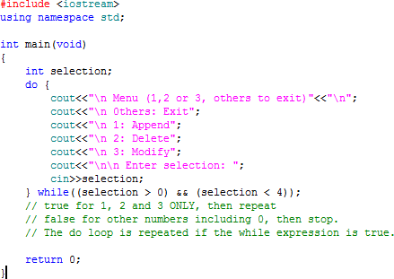
Simple Menu

Slide 67
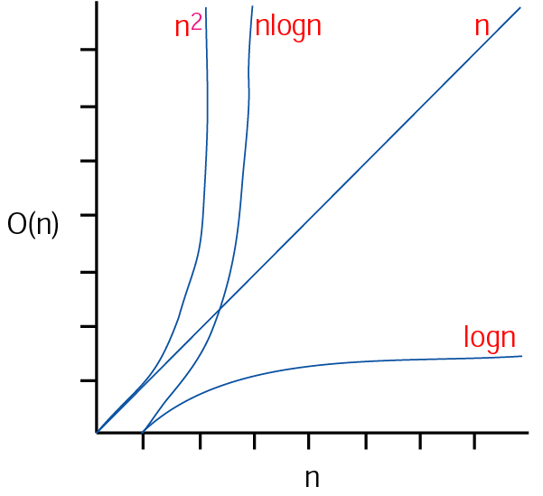
Program Efficiency Consideration

